Slide 1


CSS Custom Properties

Slide 2

Topics
Understanding CSS custom properties
Example of CSS Custom properties

Slide 3
Understanding CSS Custom properties
CSS custom properties which are sometimes referred to as CSS variables or cascading variables are entities defined by CSS authors that contain specific values to be reused throughout a document.
They are set using custom property notation example
/*declaring CSS variable */
--main-color:black
/*var() function is used to accessed the color. */
color: var(--main-color)

Slide 4
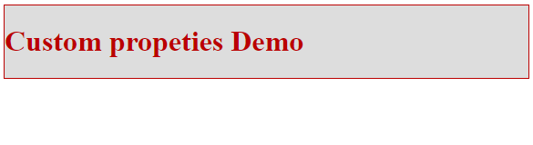
Example of CSS Custom properties
CSS custom properties example can be of Variable Color, Variable Dimensions and much more
Variable Color Example
HTML
CSS
Output
<div class="container">
<h1>Custom properties Demo</h1>
</div>
:root {
--red: #b00;
--blue: #4679bd;
--grey: #ddd;
}
.container {
color: var(--red);
background: var(--grey);
border: 1px solid var(--red);
}

Slide 5
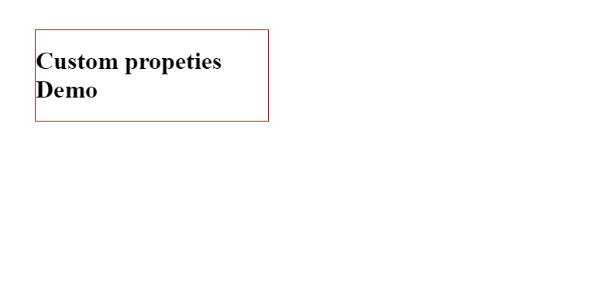
Variable Dimensions Example
HTML
CSS
Output
<div class="container">
<h1>Custom properties Demo</h1>
</div>
:root {
--w200: 300px;
--m10: 40px;
--red: #b00;
}
.container {
border: 1px solid var(--red);
width: var(--w200);
margin: var(--m10); }

Slide 6
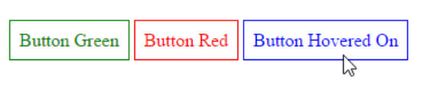
Example of Variable Cascading
HTML
CSS
<body>
<a class="button" href="#"> Button Green</a>
<a class="button btn_red" href="#"> Button Red</a>
<a class="button" href="#"> Button Hover On</a>
</body>
.button {
--color: green;
padding: 0.5rem;
border: 1px solid var(--color);
color: var(--color);
}
.button:hover {
--color: blue;
}
.btn_red {
--color: red;
}
Output

Slide 7
cal() func
You can utilize the calc() CSS function to execute calculations while defining values for CSS properties.
property: calc(expression)
The expression can be any simple expression combining the following operators, using standard operator precedence rules:
+ Addition.
- Subtraction.
* Multiplication
/ Division

Slide 8
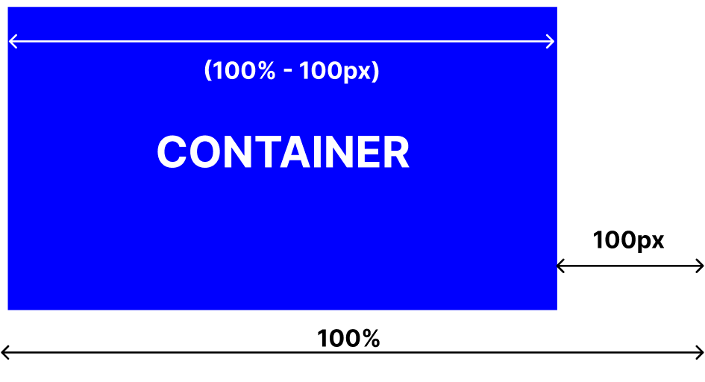
cal() Example
Code
Output
<style>
#container {
width: calc(100% - 100px);
height: 50vh;
background-color: blue;
}
</style>
<body>
<div id="container"></div>
</body

Slide 9
THANK YOU

